Slide 1
Effective Data Visualisation
Victoria Avila
Assistant Statistician

Slide 2
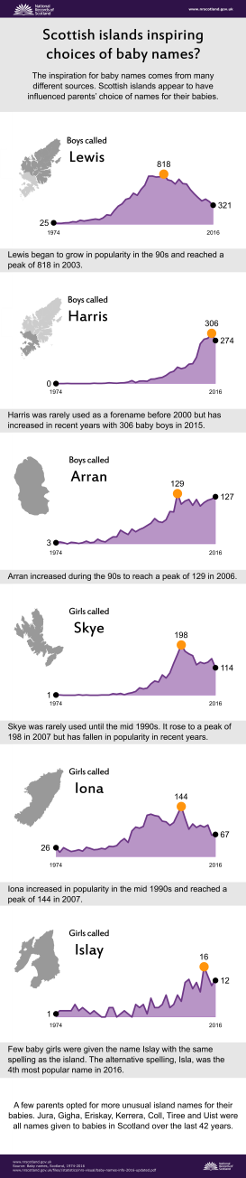
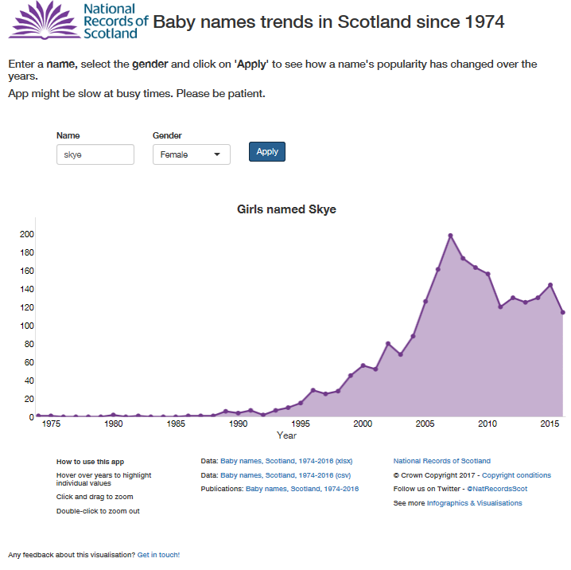
scotland.shinyapps.io/babynames

Slide 3
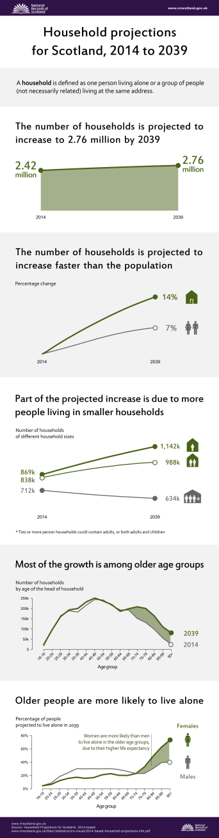
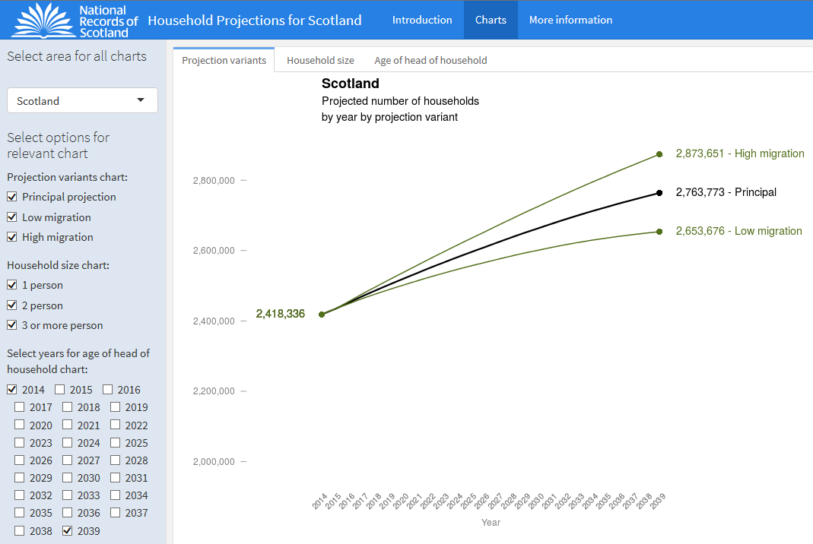
scotland.shinyapps.io/household-projection-variants

Slide 4
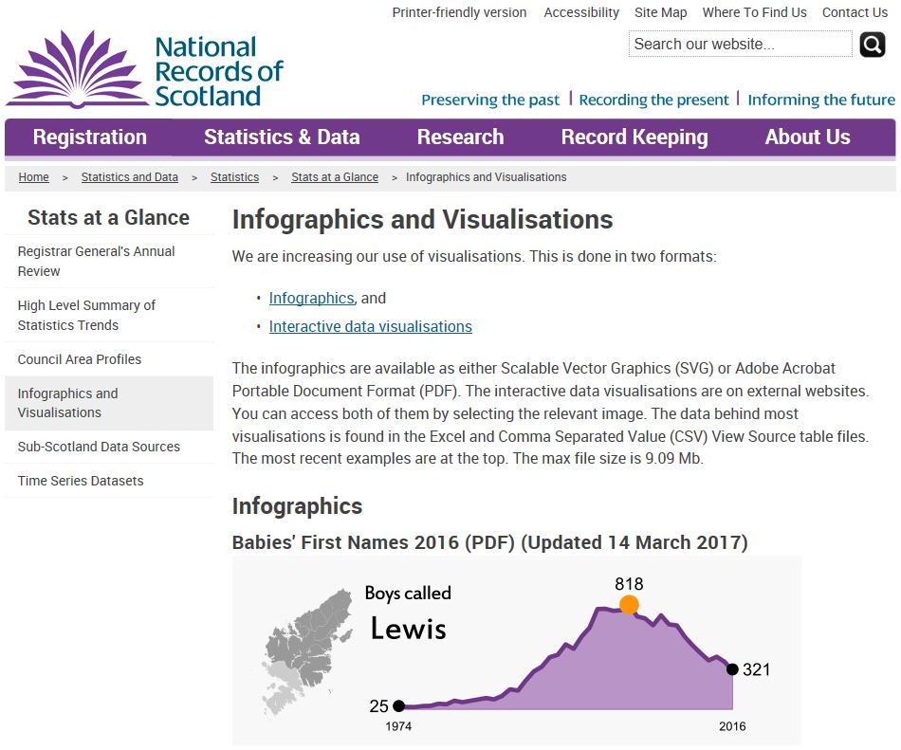
NRS infographics and visualisations
www.nrscotland.gov.uk/statistics-and-data/statistics/stats-at-a-glance/infographics-and-visualisations

Slide 5
Checklist to create effective data visualisations

Slide 6




#1 Audience

Slide 7




#1 Audience

Slide 8
#2 Message
What is the key message
and
what action you would like the user to take

Slide 9
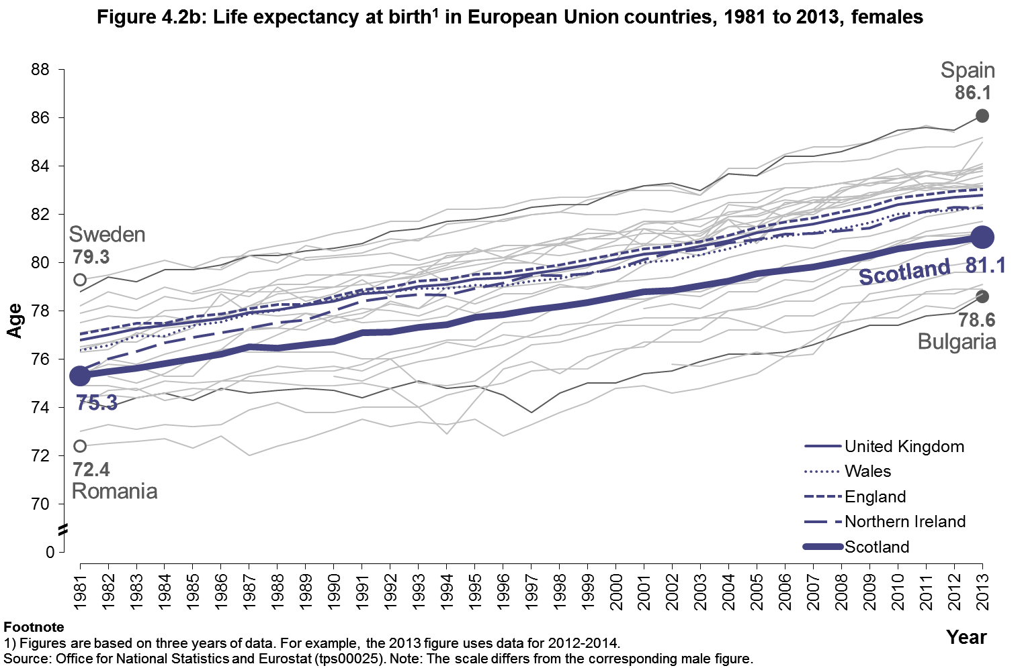
#3 Data

Slide 10
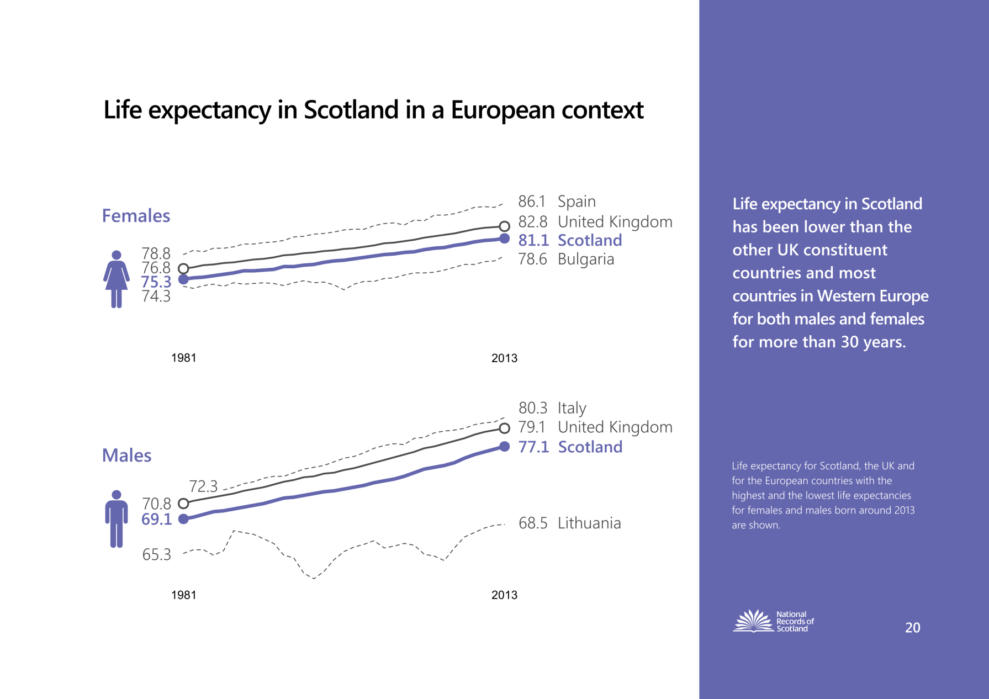
#3 Data

Slide 11
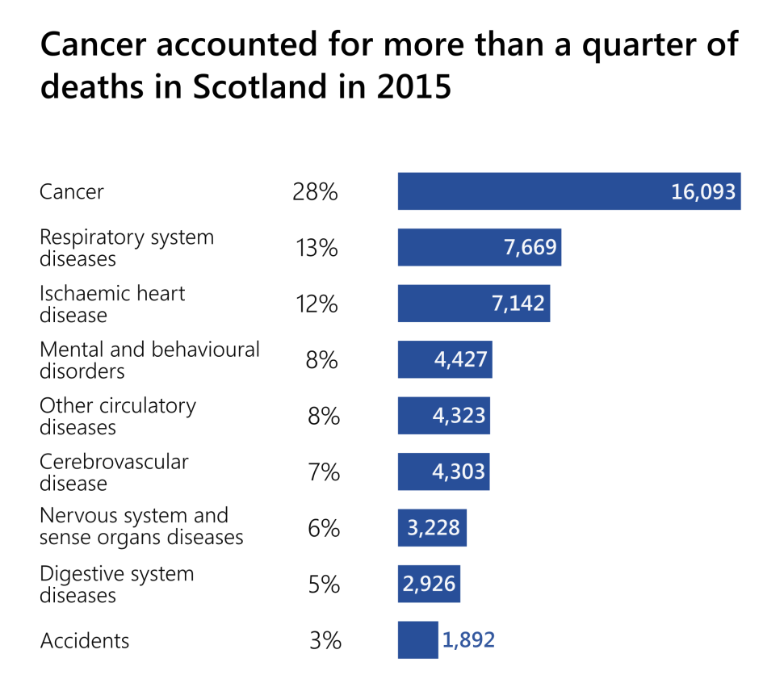
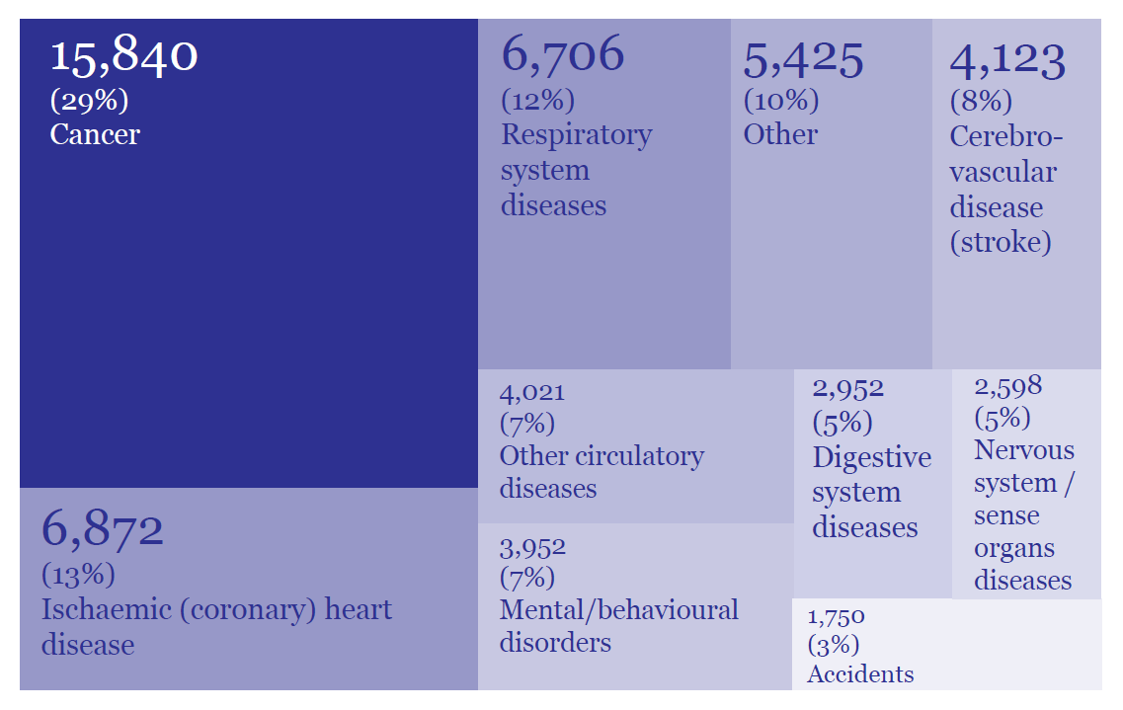
#4 Visuals
Registered deaths and main causes of death, Scotland 2014

Slide 12
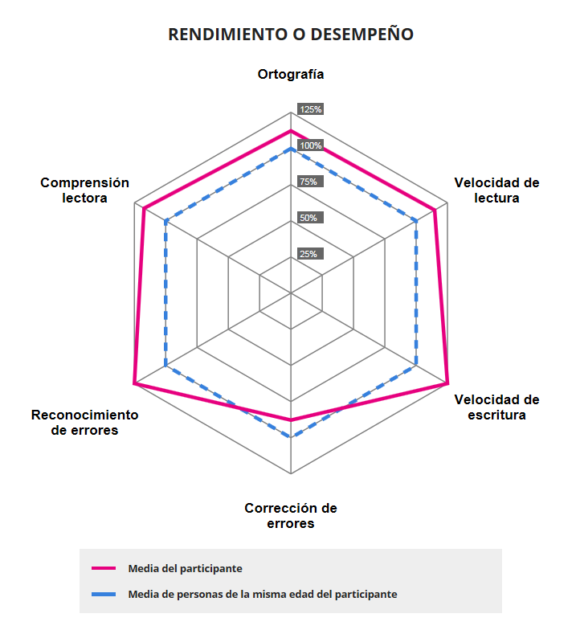
#4 Visuals
Spelling
Reading
comprenhension
Reading
speed
Typo
detection
Writing
speed
Typo
correction
Participant average
Same age group average
dytectivetest.org

Slide 13
#4 Visuals
Spelling
Writing
speed
Reading
speed
Reading
comprenhension
Typo
detection
Typo
correction
No risk
Low risk
High risk
Same age group
average (%)
Participant
average

Slide 14
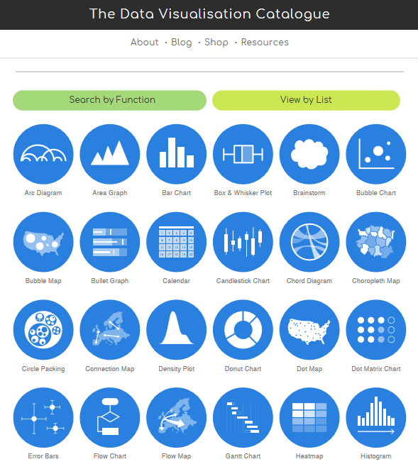
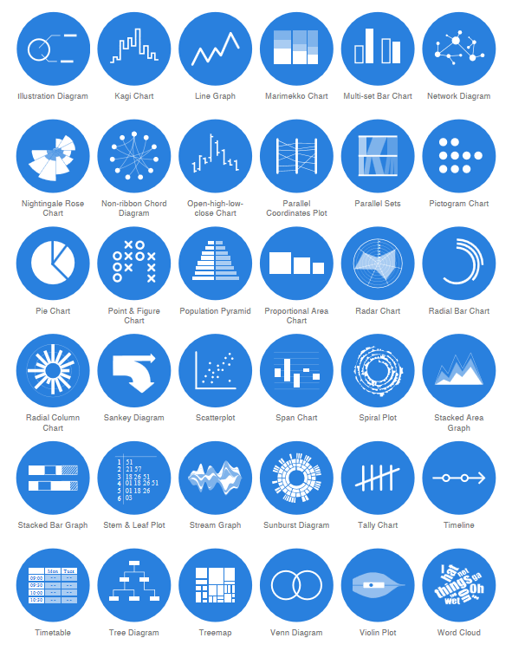
#4 Visuals
datavizcatalogue.com

Slide 15
#5 Text
Text size is hierarchical and readable
Text is horizontal
Data are labeled directly
Labels are used sparingly

Slide 16
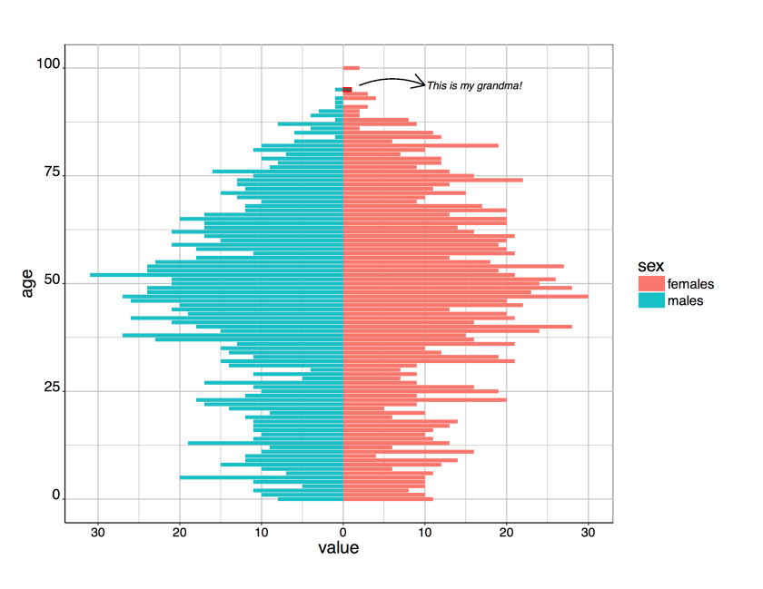
#5 Text
aledemogr.wordpress.com/2016/01/11/population-pyramids-in-ggplot

Slide 17
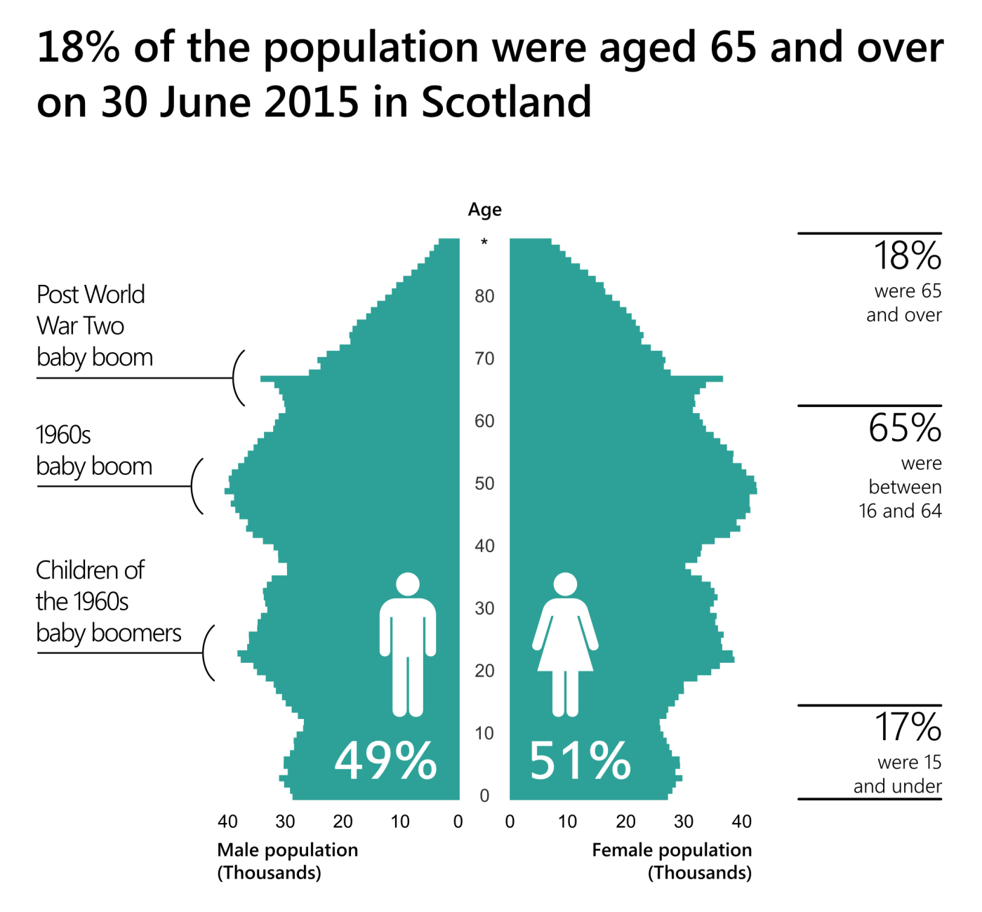
#5 Text

Slide 18
#6 Colour
Colour scheme is intentional
Colour is used to highlight key patterns
Colour is visible when printed in black and white
Colour is distinguisible even if colourblind
Text sufficiently contrasts background (contrastchecker.com)

Slide 19


Slide 20



Slide 21

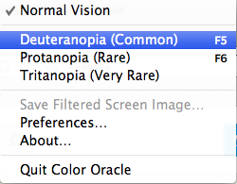
colororacle.org

Slide 22
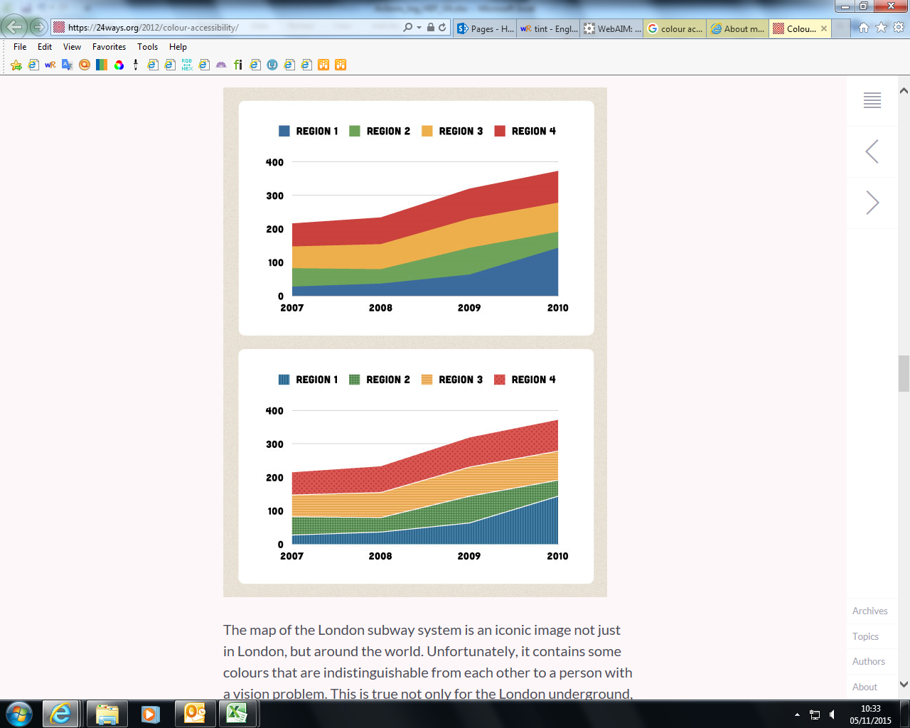
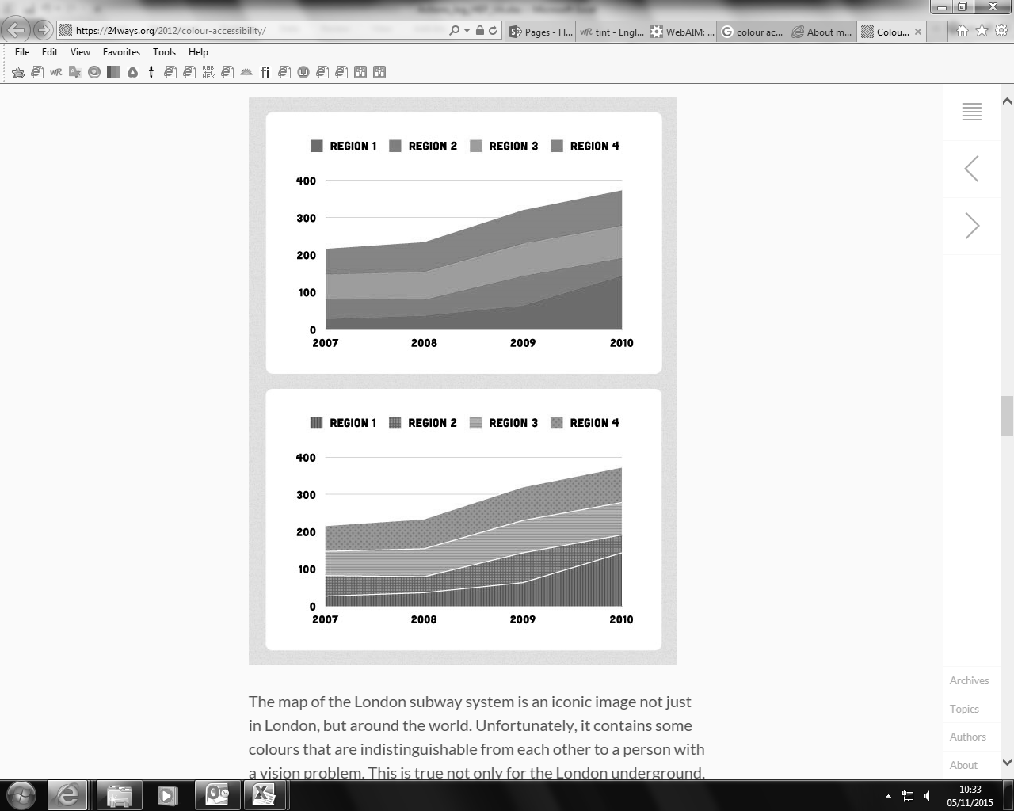
REGION 4
REGION 3
REGION 2
REGION 1
REGION 4
REGION 3
REGION 2
REGION 1

Slide 23
#7 Declutter
Are they necessary?
Gridlines
Graph border line
Axis lines and tick marks
More than one axis per dimension
Decimal places

Slide 24
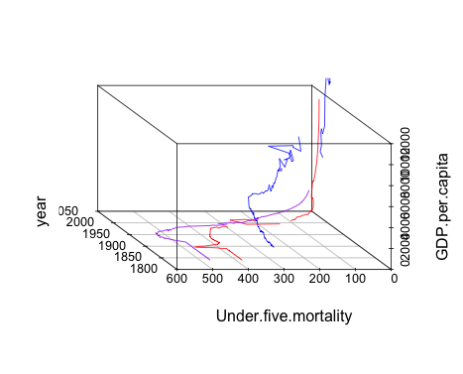
#8 Don’t use 3D
Just don’t
blog.ouseful.info/2015/07/22/doodling-with-3d-animated-charts-in-r

Slide 25

Contact
Victoria Avila
 victoria.avila@nrscotland.gov.uk
vavilaregidor@gmail.com
victoriaavilaregidor

Slide 26
Statistician recruitment
Around 35 staff at Assistant Statistician level
Salaries range from £23,383 - £31,811
Closing date: Tuesday, 9 May
Assessment between 12 and 26 June inclusive
See www.work-for-scotland.org

